Slide 1

Dynasty Cars Inventory Management System
CPT-200

Slide 2
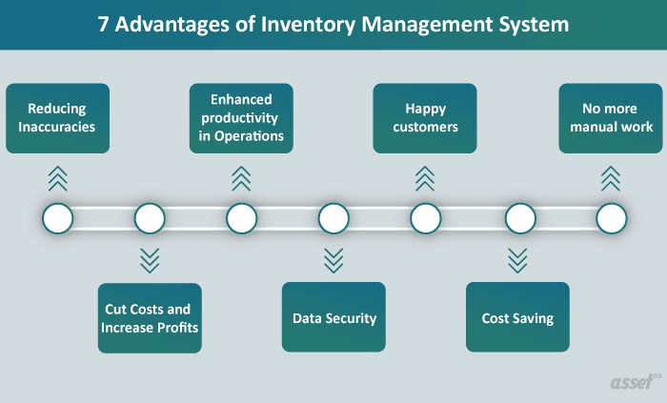
Inventory Management System
Creating a user friendly menu to search
Even more important words
You get the picture

Slide 3
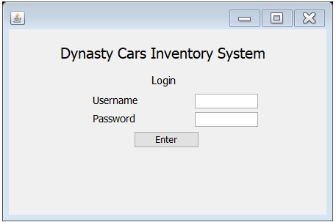
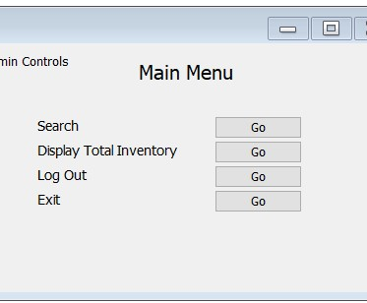
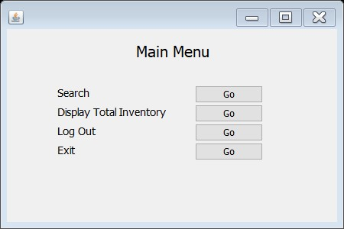
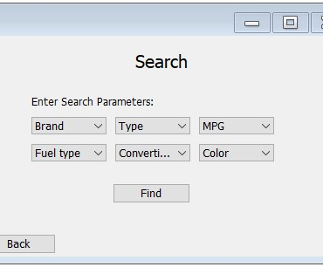
First Draft of GUI
The username and password will define the authorization level and permissions within which they operate

Slide 4

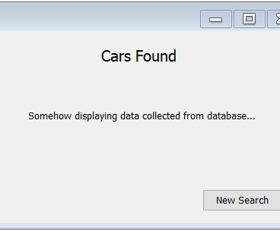
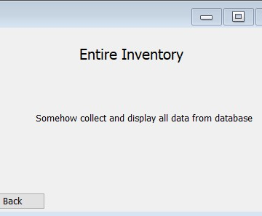
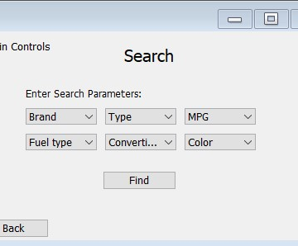
First Draft of GUI (cont’d)
We have selected the database, working on cleanup and proper way to import
Admin Controls will have the same search engine as the guest. What additional option will be added for admin?

Slide 5
Research and Development
3rd party log in

Slide 6




Roles and Responsibilities
Leo Parker
Heather Ryan
Jason Murley
Amanda Fritz
GUI setup and coding
Manage GitHub, PPT presentation, final submittal of all documentation
Put something here
UML Diagram, Database Cleanup, and Coding

Slide 7
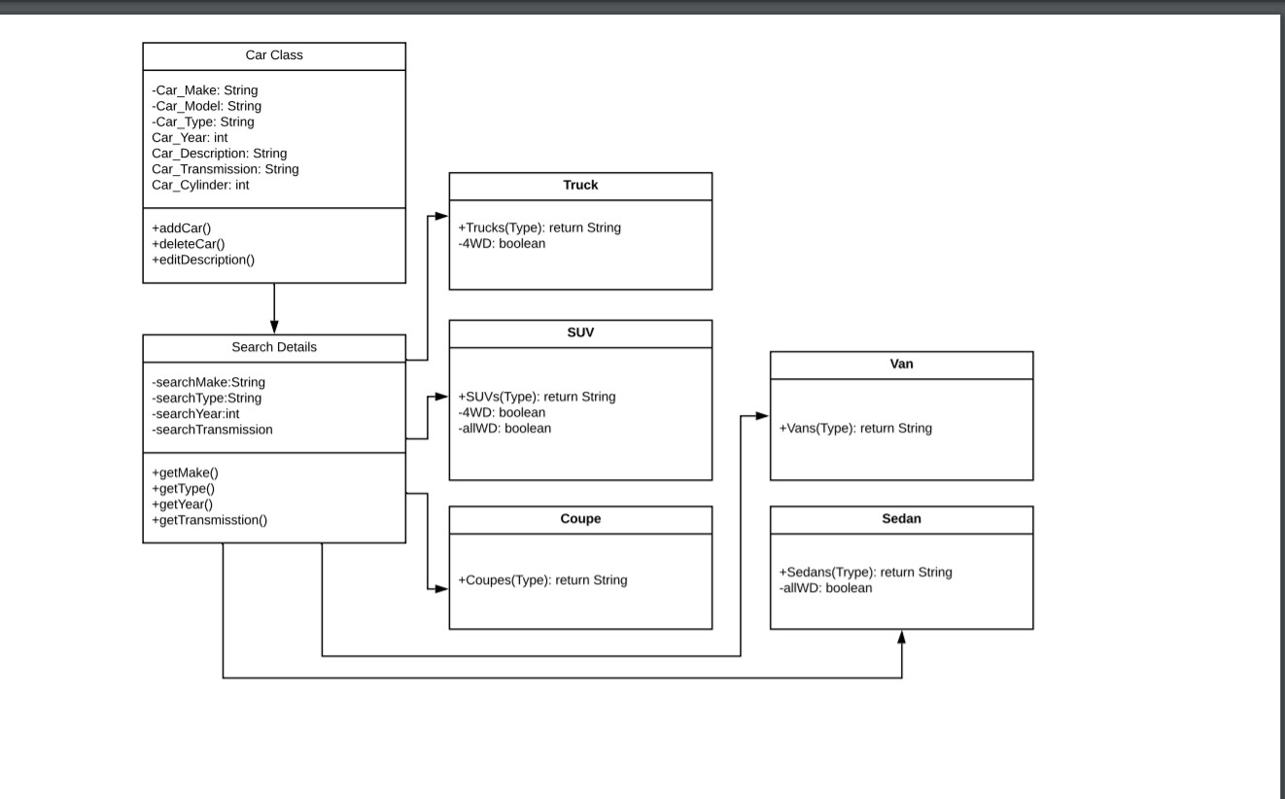
Slide 27
UML Diagram

Slide 8
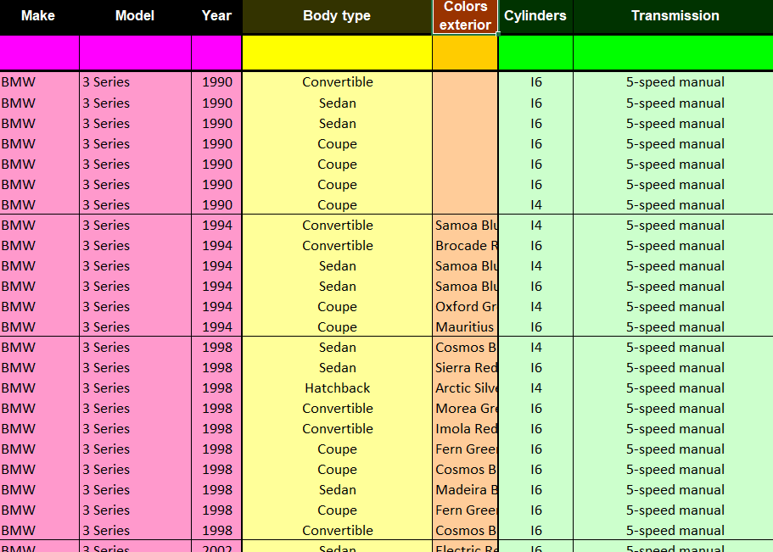
Data Base:
Using Microsoft Excel: Import Car Data
Data is Broken up into Make,
Model, Year, Type, Color, Cylinders, Transmission
Referenced: Teoalida - cardatabase.teoalida.com

Slide 9
Hardware
Software
Dell PowerEdge T30:
server for multiple users to access database
(Employees)
4 TB SAN Storage Devices
storage for database
Dell P3000 Workstations:
Single user access (customers)
Eclipse:
create code
Java:
code language
Swing:
produce GUI
GitHub:
share project progress
Microsoft Office:
powerpoint presentation
database

